Slide 1
MULTIPATH FADING
Vivya Kalidindi
September 09, 2019.

Slide 2
Multipath[1] occurs when a signal takes two or more paths from the transmitter to the receiver.
A fundamental challenge of indoor localization is the presence of multipath effects. Due to the inherent nature of the signals[2], they can be reflected, refracted and diffracted of the walls, metals, and in some cases even human beings.
References:
[1]D. Chew, “The Wireless Internet of Things,” 2018.
[2]Zafari, F., Gkelias, A. and Leung, K.K., 2019. A survey of indoor localization systems and technologies. IEEE Communications Surveys & Tutorials.

Slide 3
Mechanisms of multipath in indoor environments[1]
Reflection - a beacon signal can reflect off of an object and be re-directed towards the receiver.
Diffraction - Diffraction occurs when the radio path between transmitter and receiver are blocked by the sharp edges.
Refraction - When beacon signal passes off a object, there will be change in distance and time delay when receiver receives the signal.
These properties might affect in location accuracy.
References:
[1]C.-C. Pu and W.-Y. Chung, “Mitigation of Multipath Fading Effects to Improve Indoor RSSI Performance,” IEEE Sensors Journal, vol. 8, no. 11, pp. 1884–1886, 2008.

Slide 4
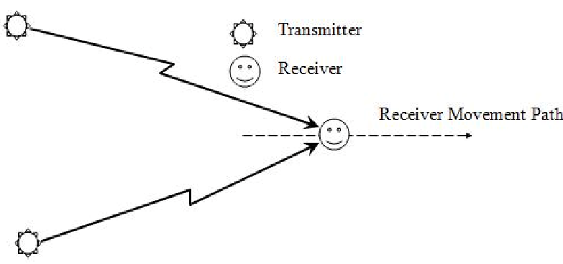
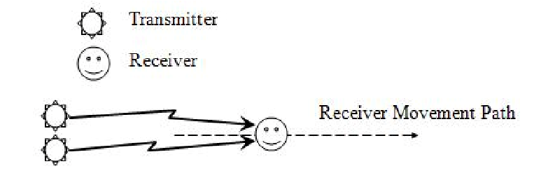
Path Analysis for RSSI in indoor environments[1]
Experimental Setup:
Fig 1, two transmitters are near to each other. Fig 2, two transmitters are far from each other.
References:
[1]Pu, C.C. and Lee, H.J., 2009. State and path analysis of RSSI in indoor environment. In International IACSIT Conference on Machine Learning and Computing (ICMLC 2009) (pp. 289-293).

Slide 5
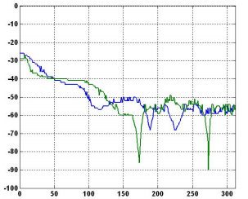
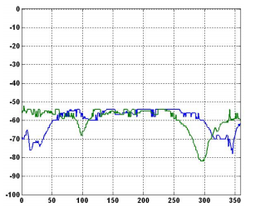
Experiments Results[1]:
Fig.1: Results for both the transmitters are near to each other.
Fig.2: Results for both the transmitters are near to each other.
References:
[1]Pu, C.C. and Lee, H.J., 2009. State and path analysis of RSSI in indoor environment. In International IACSIT Conference on Machine Learning and Computing (ICMLC 2009) (pp. 289-293).

Slide 6
Authors concluded that RSSI signals are close to each other because two transmitters are near to each other but not same due to different paths.
In case of NLOS available in indoor environments, RSSI signals reduce drastically.
However, it is possible to detect by comparing RSSI signals from another transmitter with near location.
References:
Pu, C.C. and Lee, H.J., 2009. State and path analysis of RSSI in indoor environment. In International IACSIT Conference on Machine Learning and Computing (ICMLC 2009) (pp. 289-293).

Slide 7
Conclusion
We can exploit the BLE dataset which was created by Western Michigan university.

